Slide 1


2025 CITY OF LITTLE ROCK Disparity Study

Slide 2




Denver, CO
PRIME CONSULTANT
SANKOFA COMMUNITY STRATEGISTS
Little Rock, AR
Calabasas, CA
INTERVIEW &
PROGRAM EXPERT
SURVEY EXPERT
Atlanta, GA
LEGAL EXPERT

Slide 3





Slide 4
Assess disparities between participation and availability
Assess marketplace barriers
Recommend refinements
Refine implementation of Federal DBE Program

Slide 5
Provide evidence of barriers
Inform remedial efforts
Ensure constitutionality

Slide 6




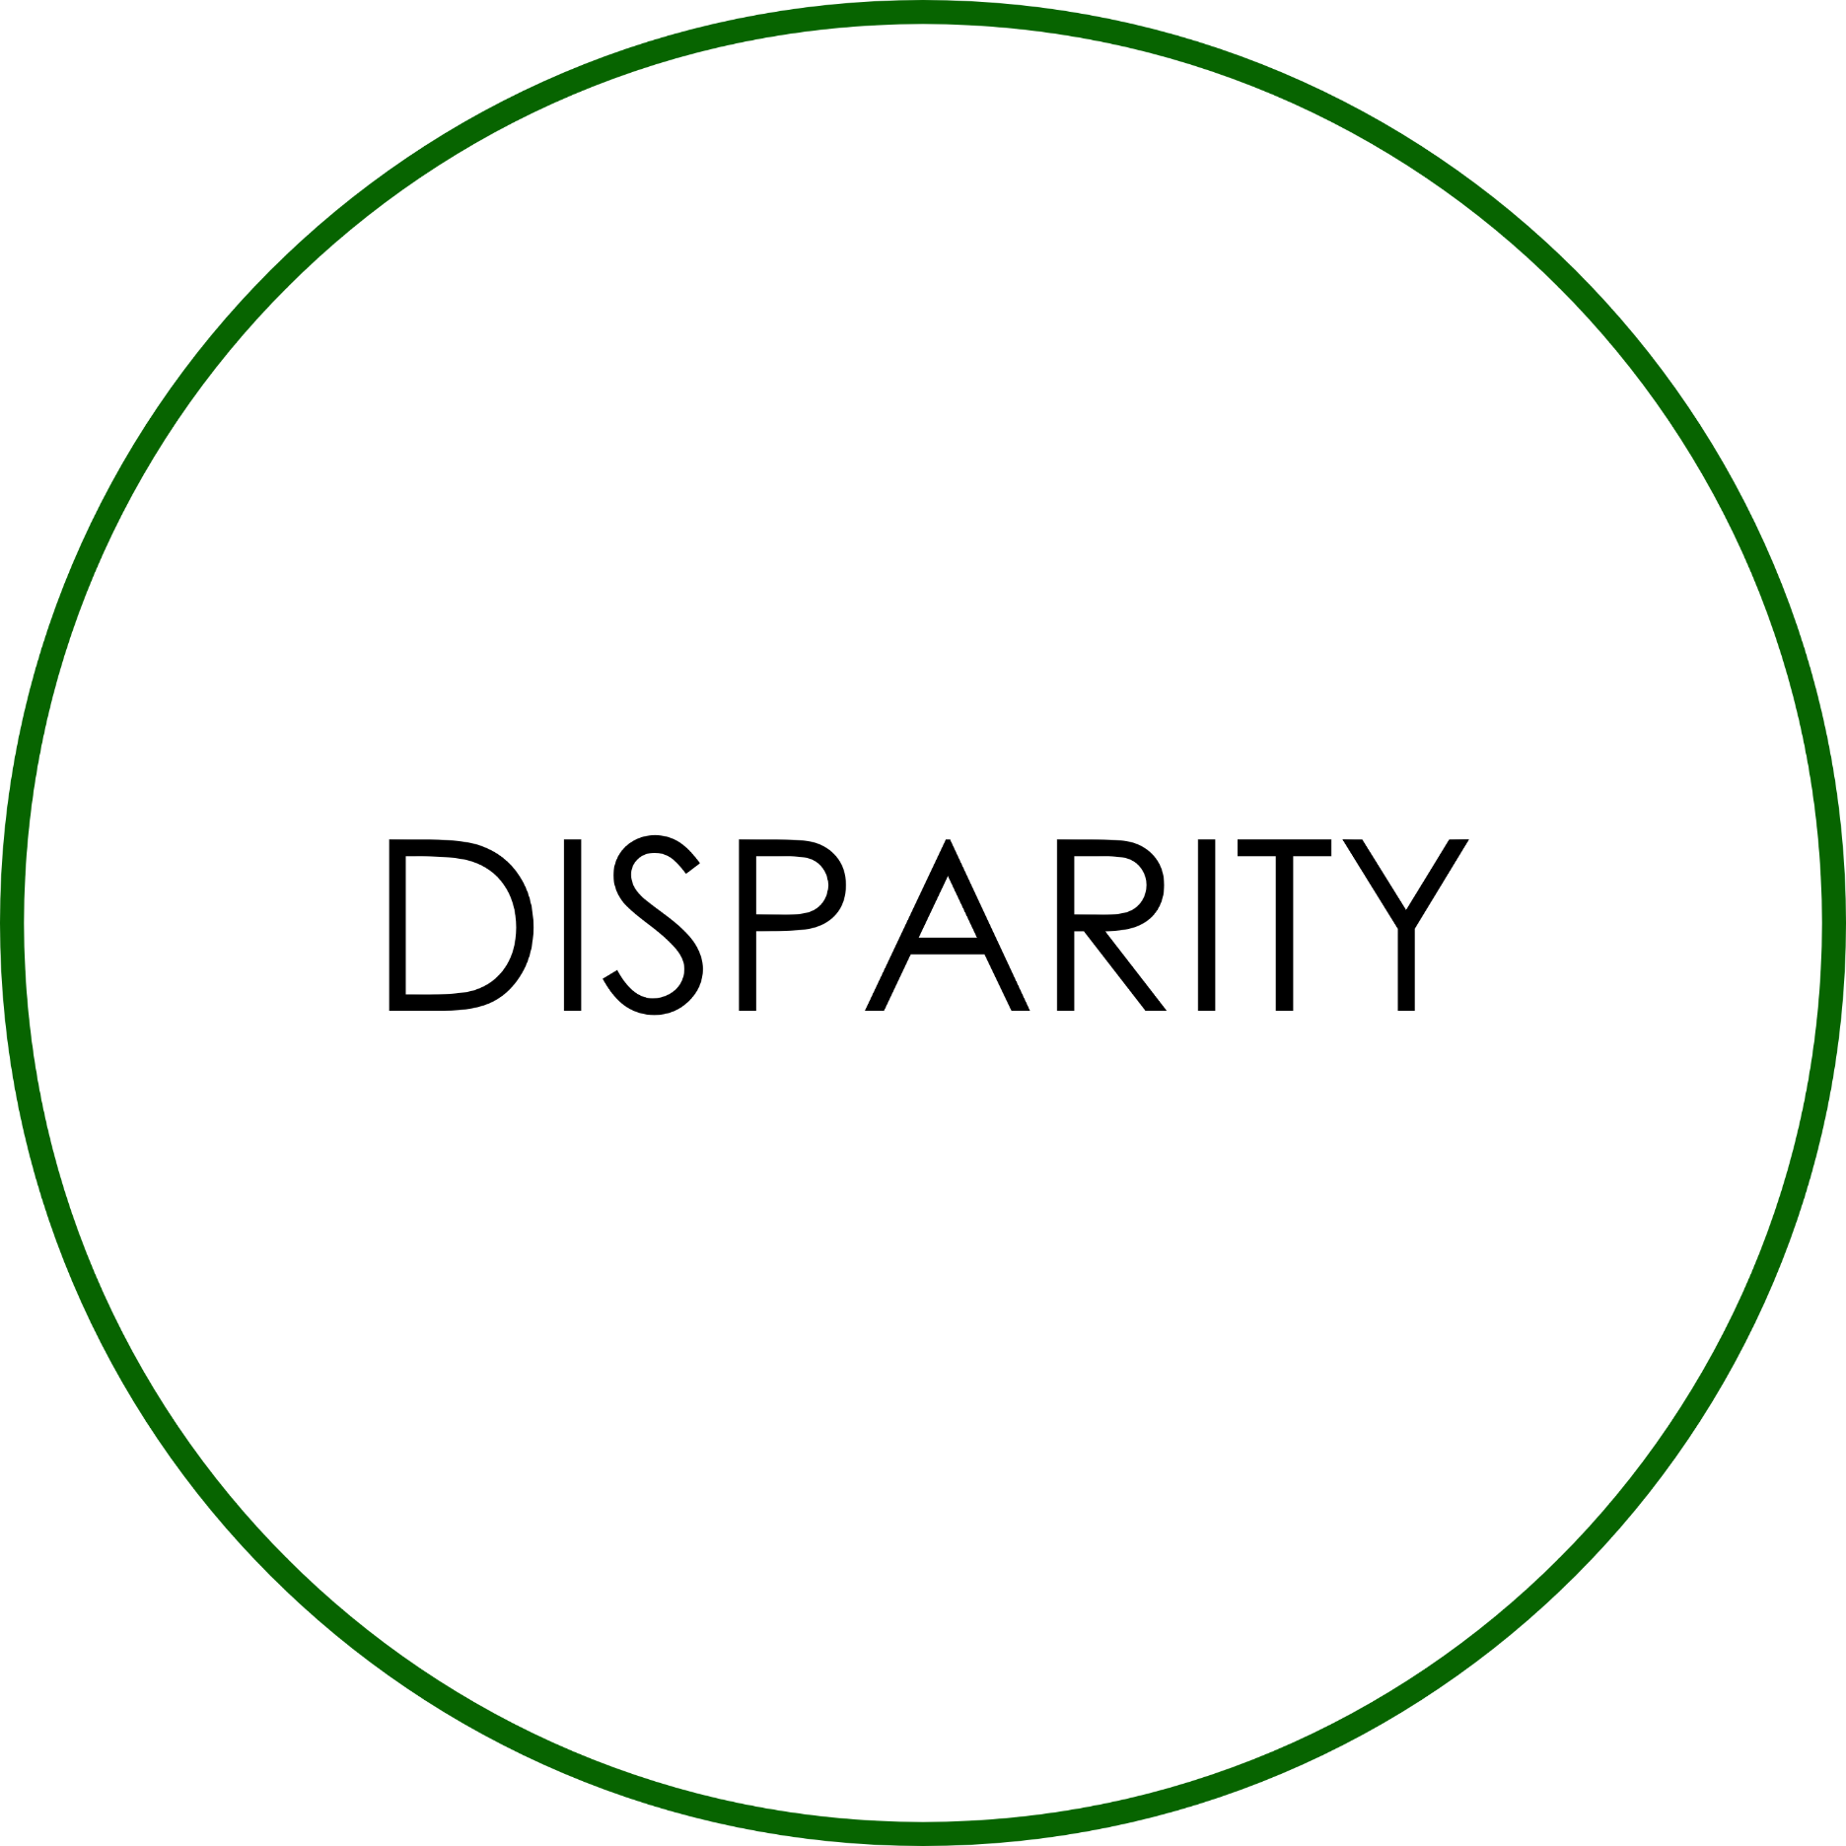

Slide 7

SANKOFA COMMUNITY STRATEGISTS
Webpage/email
Task notices
Presentations
Public meetings
Business surveys
Interviews
Focus groups

Slide 8
BBC RESEARCH AND CONSULTING TEAM
Systems, types, and formats
Data requests and collection
Program and policy analysis
City consultation and reviews

Slide 9
AGENCY DATA
SURVEY
DATA
Construction/ professional services/ non-professional services/ supplies
Prime and subcontracts
Five-year study period
Lines of work
Business size
Geography
Ownership

Slide 10
CUSTOM CENSUS
Lines of work
Vendor role
Business size
Geography
Capacity
Interest
Ownership

Slide 11

Dollars awarded
=
Disparity Index
X 100
Dollars available
< 80 = substantial disparity

Slide 12
JUNE
JULY
AUGUST
SEPTEMBER
OCTOBER
NOVEMBER
DECEMBER
JANUARY
FEBRUARY
MARCH
APRIL
MAY
Project initiation Data assessment
Data analysis
Community engagement
Data review
Draft report
Final report

